Slide 1
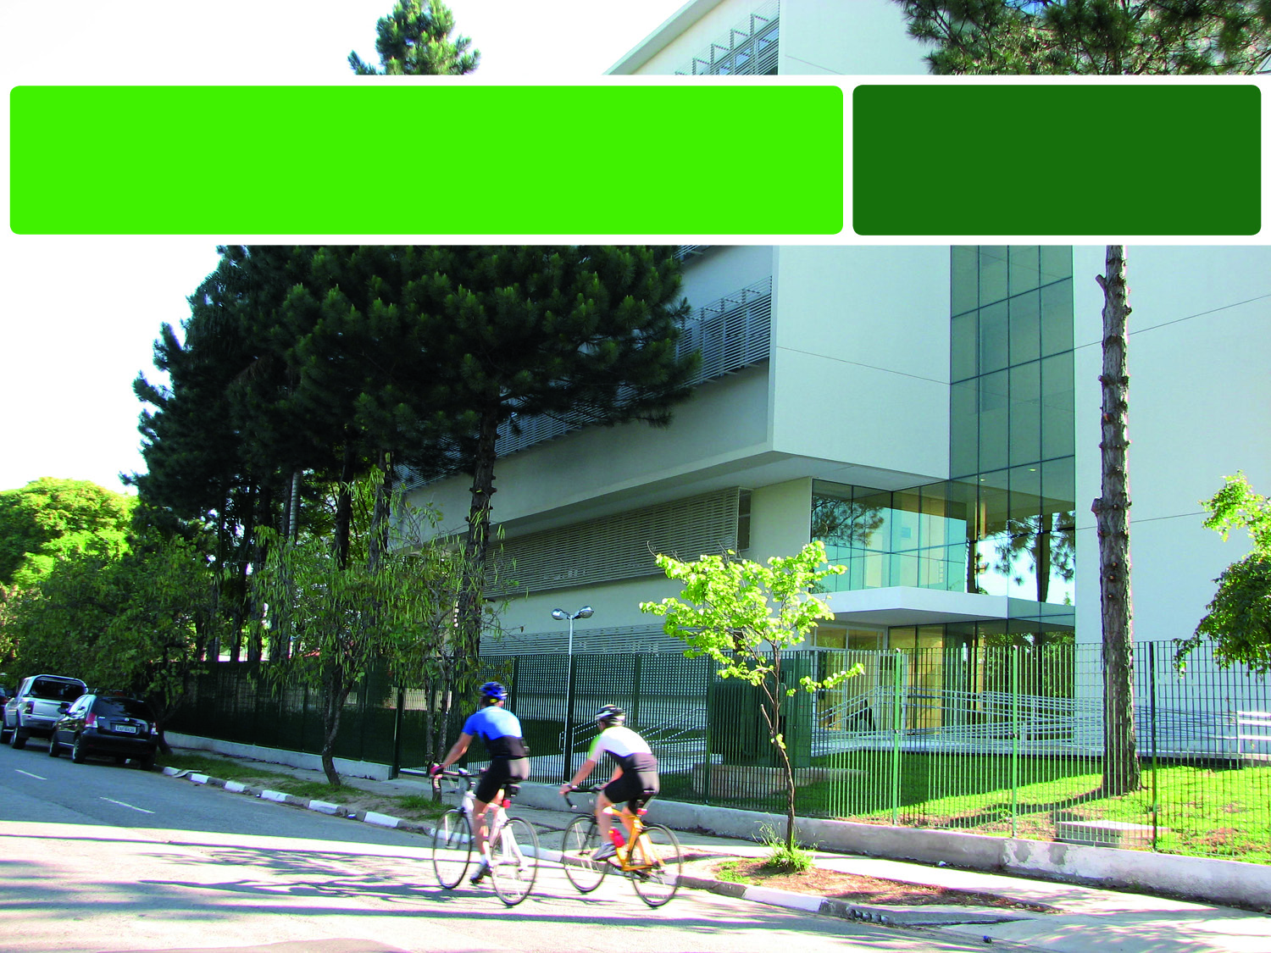
School of Physical Education and Sport
University of São Paulo

Slide 2
History
First civil institution of the area in Brazil
1934 Establishment of the Physical Education School
1969 Incorporation to the University of São Paulo
1977 Establishment of the Master’s Program
1989 Establishment of the Doctoral Program
1992 Readjustment of the Curricular Structure
2010 Completion of the Laboratories Building

Slide 3
First class - 1934
Internship at the School of Physical Education of the Army - Rio de Janeiro (Brazil)

Slide 4
Mission
To provide quality education and produce innovative knowledge in the areas of Physical Education and Sport, in an interdisciplinary and applied way, interacting with the society.
Commemorative sculpture of the 70th anniversary of EEFE, reproduced under perspective. Original work by Professor Erasmo Castro de Tolosa.

Slide 5
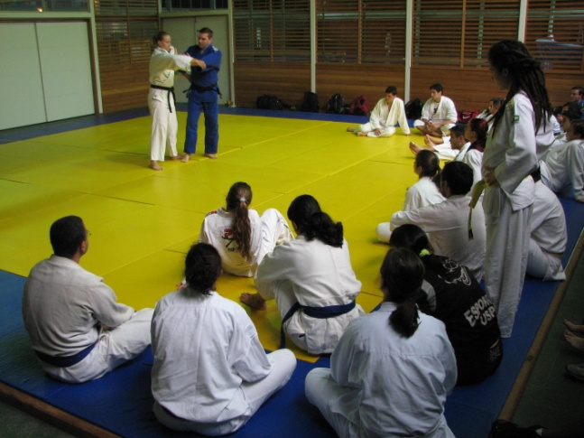
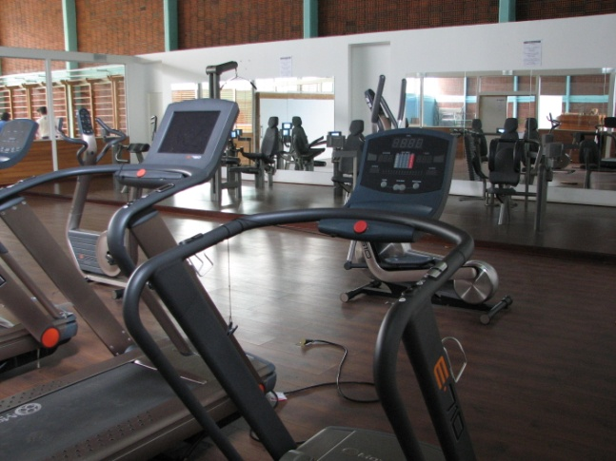
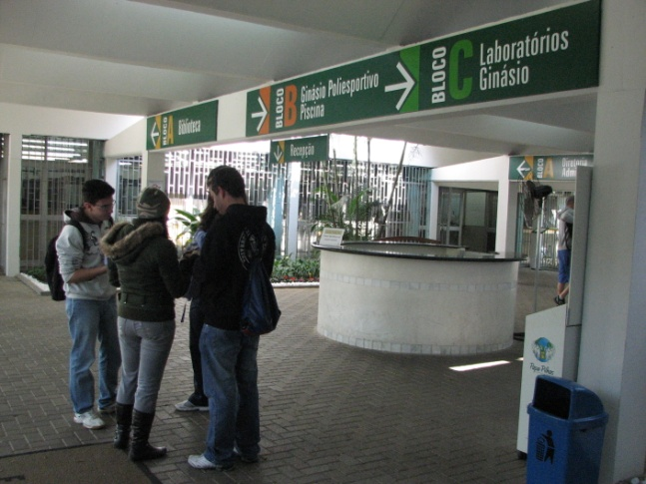
Facilities
Pool
Mat
Gym
Among others: classrooms, vivarium, sports courts, Olympic gymnastics and dancing hall, videoconference technology, teachers’ rooms, administration area, computer room for students and laboratories.

Slide 6
Laboratories Building
Inaugurated in 2010, it has a total area of 2099.5 m² where there are Laboratories, Professors’ Offices and Auditorium.

Slide 7
Courses

Slide 8
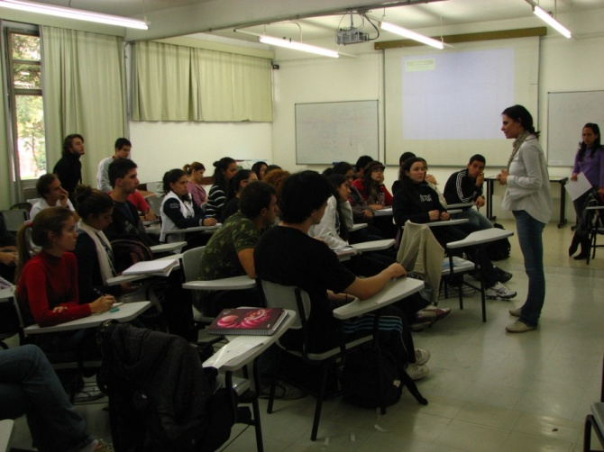
Undergraduate
Bachelor degree in Sport
Bachelor degree in Physical Education
Teaching degree in Physical Education

Slide 9
Graduate
Grade in the Federal Government Evaluation: 7 (maximum grade)
Graduate programs
(Master’s and Doctorate)
Study areas:
Biodynamic Studies of Physical Education and Sport
Sociocultural and Behavioral Studies in Physical Education and Sport

Slide 10
Research

Slide 11
Research
Research is one of the greatest concerns of the School of Physical Education and Sport.
The studies are developed in the Labs and Research Groups, involving professors, students, researchers and specialized technicians.

Slide 12
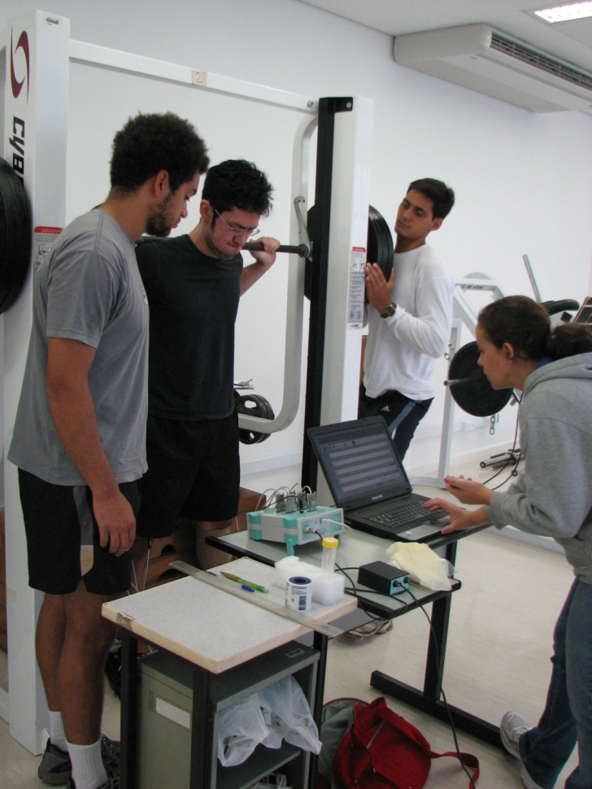
Adaptation to Strength Training Lab
Study Areas:
Neuromuscular Adaptations to Strength Training;
Sports Performance;
Models for Strength Training;
Therapeutic effects of strength training.

Slide 13
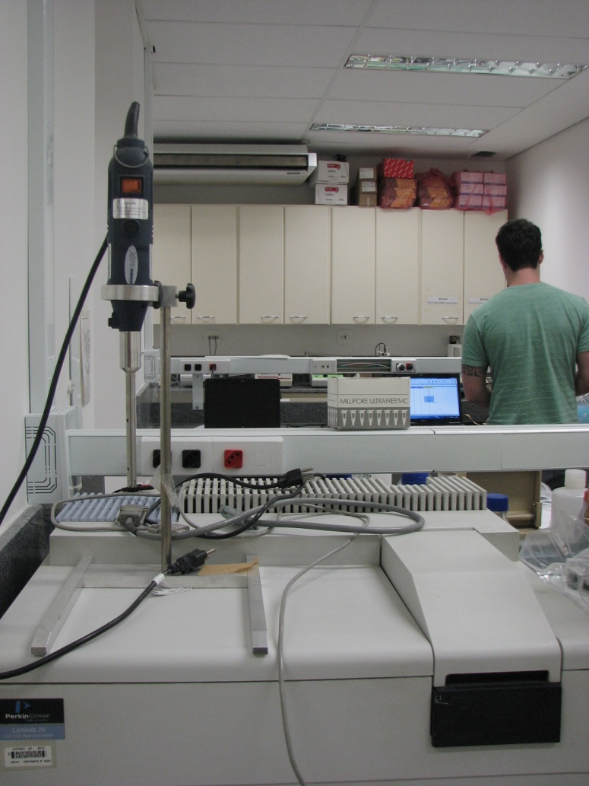
Applied Nutrition and Metabolism Lab
Study Areas:
Obesity: metabolic aspects and exercise;
Creatine supplementation;
Leucine supplementation and other amino acids.

Slide 14
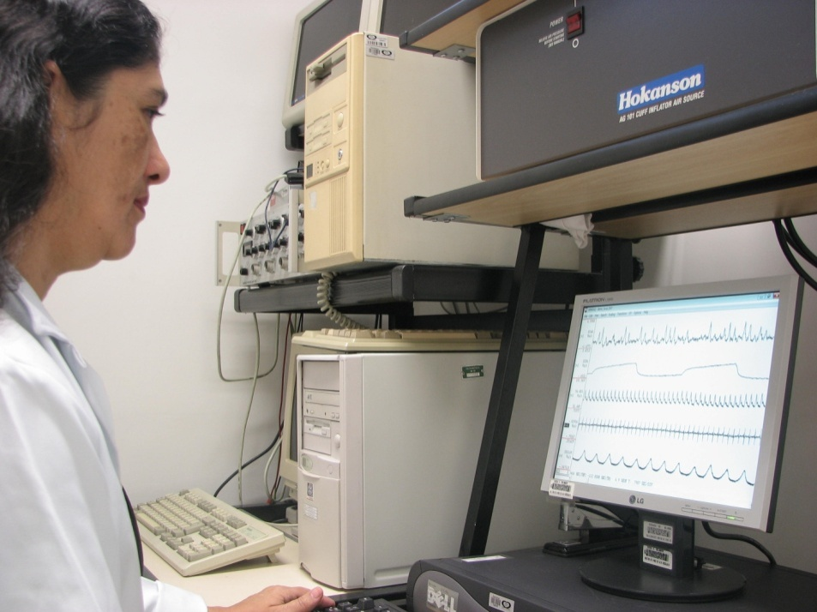
Autonomic Control of the Blood Flow Lab
Study Areas:
Acute and chronic effects of exercise on the cardiovascular system;
Therapeutics for acute coronary syndromes.

Slide 15
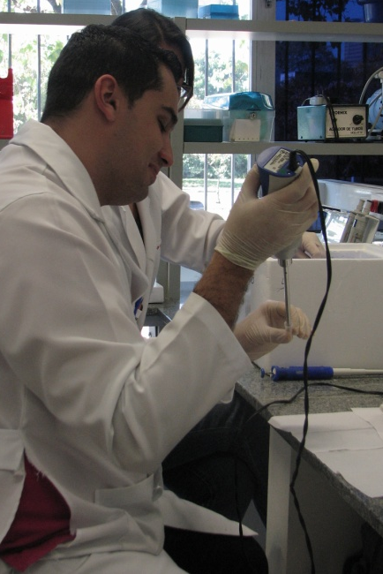
Biochemistry and Molecular Biology of the Exercise Lab
Study Areas:
Acute and chronic effects of the exercise on the cardiovascular system;
Physical exercise and oxidative stress;
Interrelation energy hormones substrates during exercise;
Physical training and metabolic impact caused by the ingestion of glucose;
Biochemical and molecular aspects of the cardiac hypertrophy caused by physical training.

Slide 16
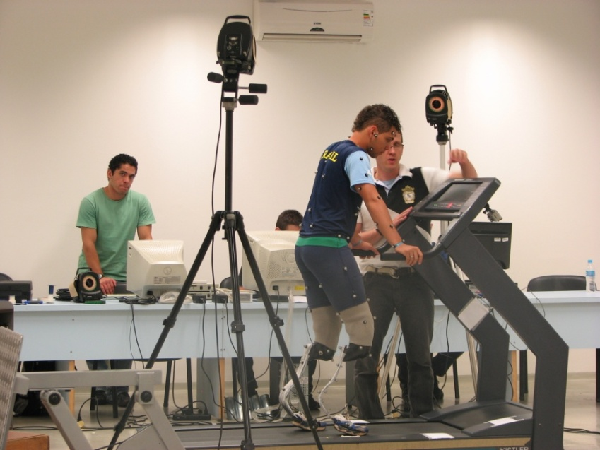
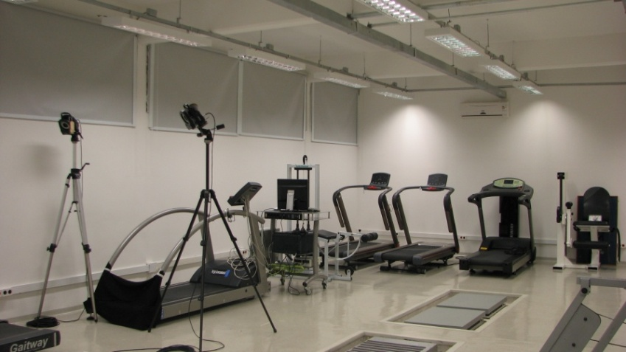
Biomechanics Lab
Study Areas:
Biomechanics of the locomotion;
Internal forces and biomechanical models;
Sports biomechanics;
Biomechanics of the postural control;
Instrumentation applied to biomechanics.

Slide 17
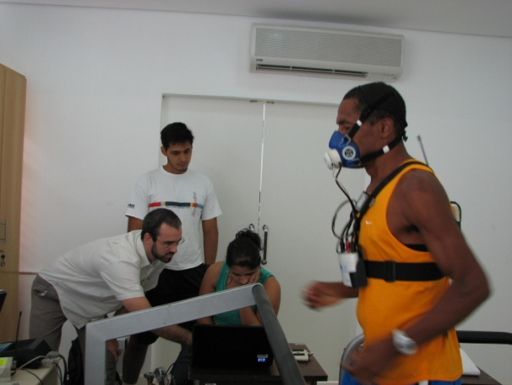
Energy Determinants of Sport Performance Lab
Study Areas:
Endurance evaluation;
Body composition of sportsmen;
Physical conditioning;
Sport performance;
Sport and disability.
Related research groups:
Biological Evaluation of Sport;
Wrestling, Martial Arts and Combat Methods.

Slide 18
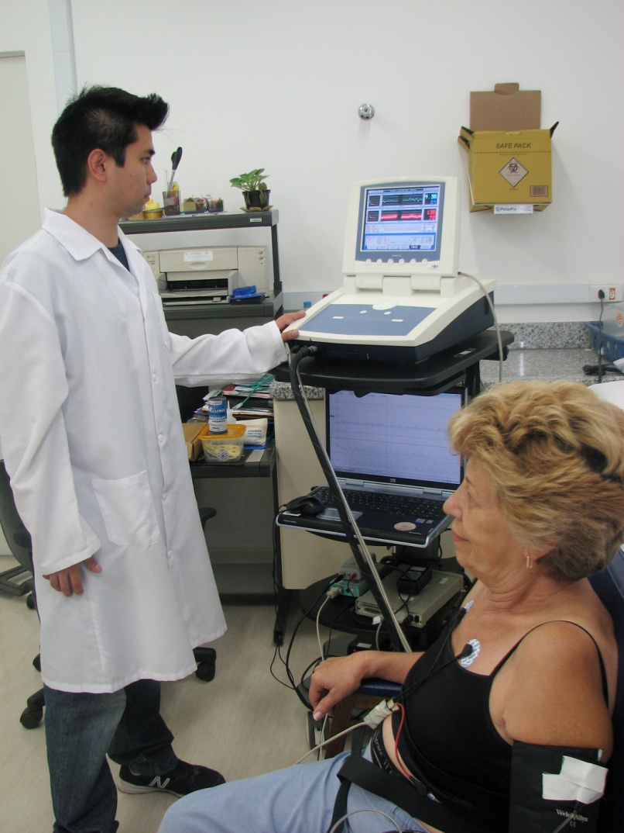
Exercise Hemodynamic Lab
Study Areas:
Acute and chronic effects of the exercise on the cardiovascular system;
Exercise and mental health;
Neural control of the circulation.

Slide 19
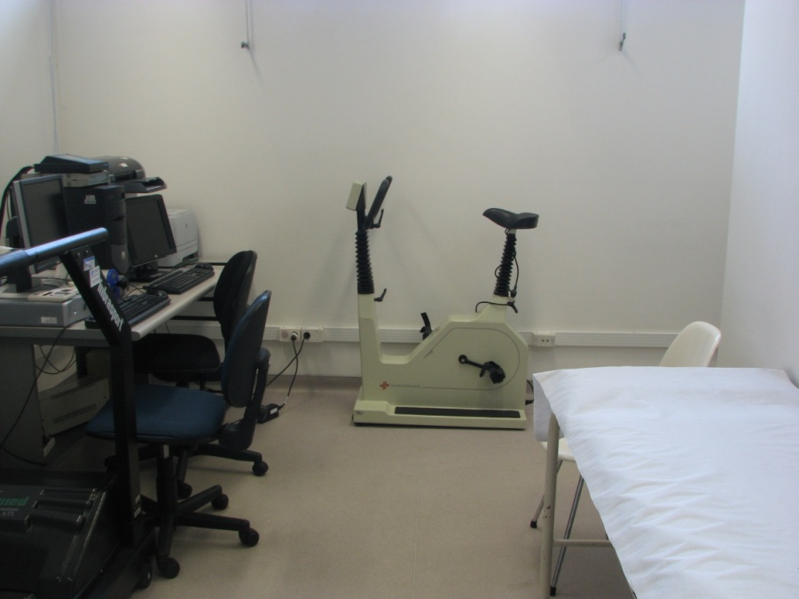
Exercise Physiology and Cardiac Rehabilitation Lab
Study Areas:
Acute and chronic effects of the exercise on the cardiovascular system;
Heart Failure and Cardiomyopathy.

Slide 20
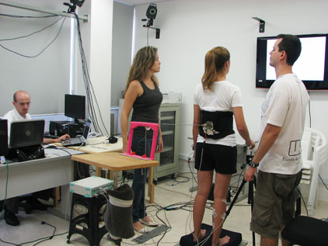
Human Motor Systems Lab
Study Areas:
Motor behavior and aging;
Postural Control;
Laterality and motor behavior.

Slide 21
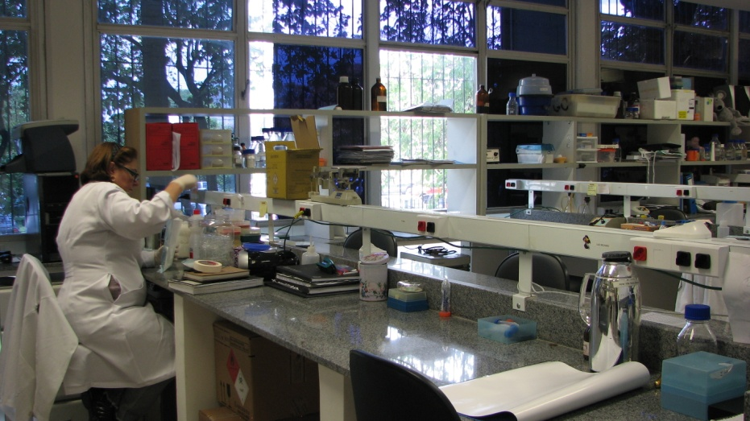
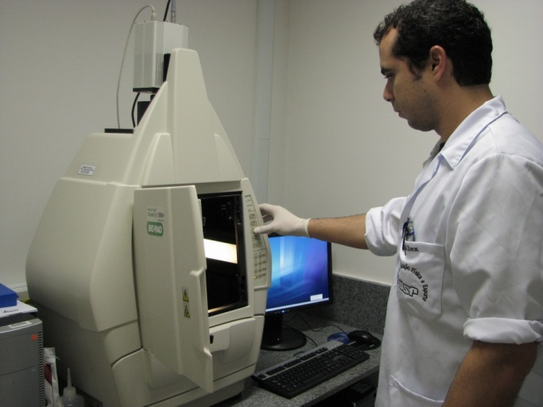
Molecular and Cellular Physiology in Exercise Lab
Study Areas:
Acute and chronic effects of the exercise in the cardiovascular system;
Heart failure and cardiomyopathy.

Slide 22
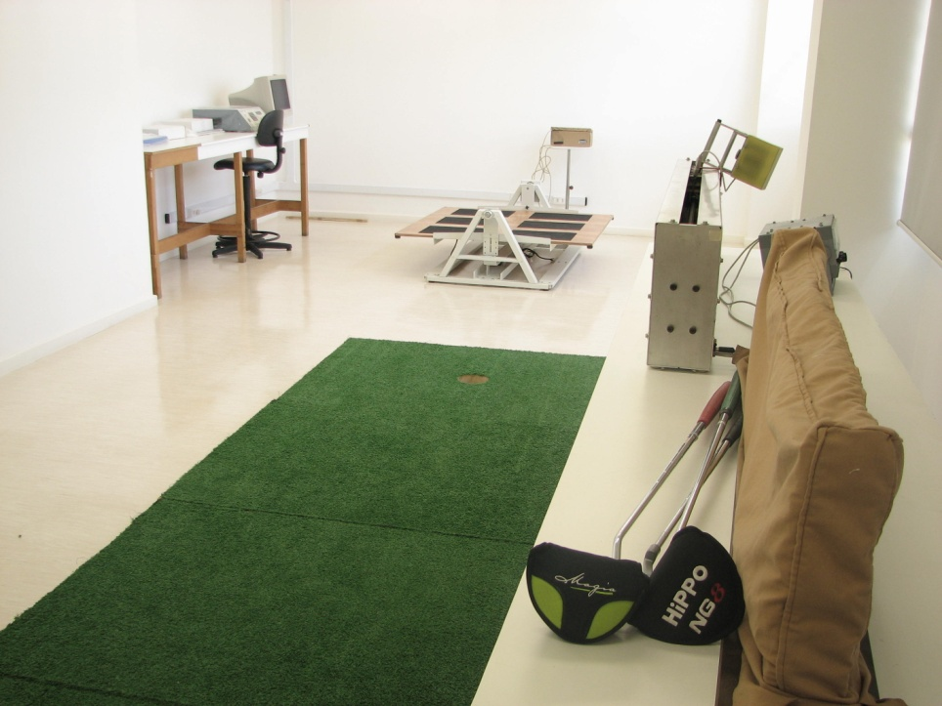
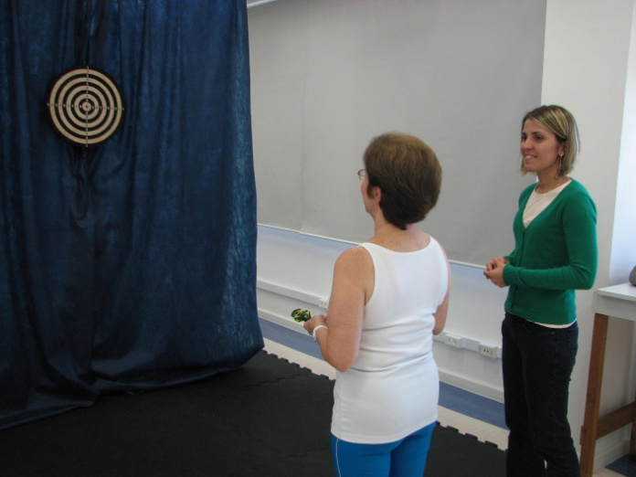
Motor Behavior Lab
Study Areas:
Motor development analysis and diagnosis;
Motor response organization.

Slide 23
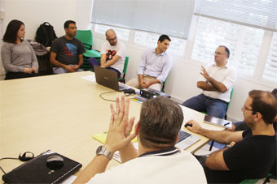
Management , Policy, Marketing and Communication in Sport and Physical Education Lab
Study Area:
Management, Politics, Marketing and Communication in Sport and Physical Education.
Related research groups:
Sport Management;
Communication and Marketing in Sport.

Slide 24
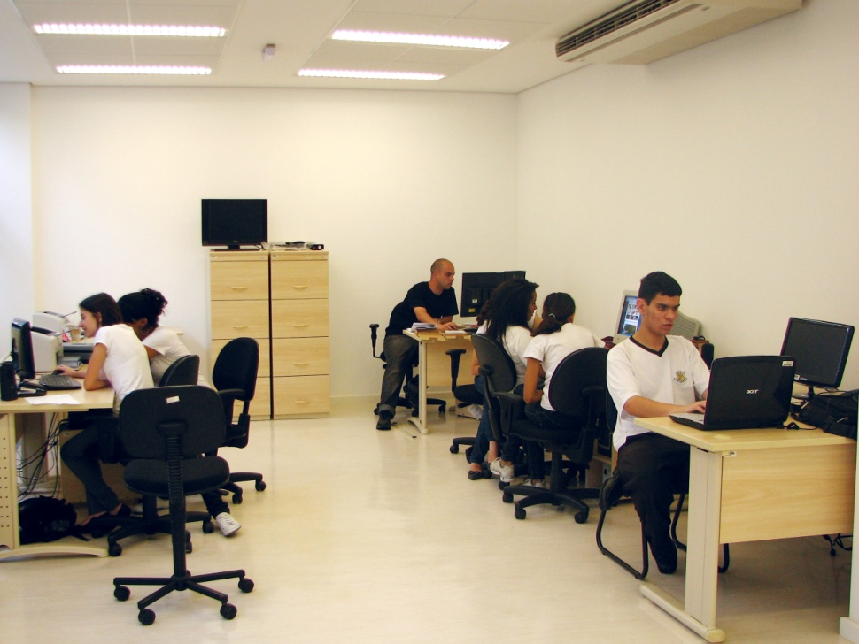
Human Movement Pedagogy Lab
Study Areas:
Curricular development;
Professional preparation.
Related research groups:
Human Movement and Physical Education Pedagogy;
CORPUS – Physical Education + Collective Health + Philosophy;
Development of the Motor Action and Intervention;
Physical Education Pedagogy.
Pregnancy and Physical Activity.

Slide 25
Genetics Applied to Exercise and Nutrition Lab
Study Areas:
Identification of polymorphisms and polygenic profiles associated with physical exercise training
Effects of ergogenic nutritional resources on physiology and performance
Physiological roles of histidine dipeptides (carnosine and anserine) for normal function and protection against chronic diseases

Slide 26
NeuroSports Lab
Study Areas:
Neuromodulation in sport and physical exercise.
Organization, structuring, monitoring and responses to adapt the physical and sports training process;
Relationship between stress, upper respiratory tract infections, internal load and external load;
Acute and chronic neuroimmuno-endocrine responses in sports training;
Fatigue and recovery: mental fatigue, brain recovery and performance;
Game and performance analysis in sport.

Slide 27
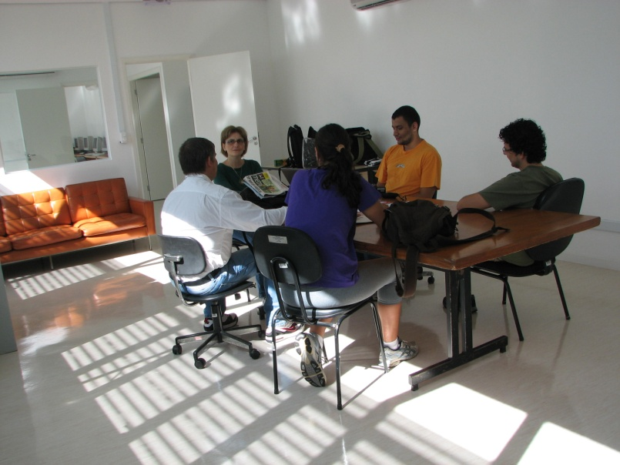
Centre for Sociocultural Studies on the Human Movement
Study Areas:
Cultural and historical studies of the human movement and its manifestation;
Sport imaginary;
Social psychology of the human movement;
Philosophical and anthropological aspects of the human movement;
Leisure.
Related research groups:
Sport Psychology Observatory;
Olympic Studies;
Interdisciplinary Study Group on Soccer.
Pula

Slide 28
Research Groups
Knowledge and Practices for Physical Education Teachers;
Physical Education Pedagogy;
Pregnancy and Physical Activity
CORPUS – Physical Education + Collective Health + Philosophy;
Development of the Motor Action and Intervention;
Research on School Physical Education and Educational Sport;
Olympic Studies;
Pula Study Group;
Interdisciplinary Study Group on Soccer;
Sport Psychology Observatory;
Neuromuscular Adaptations to Strength Training;

Slide 29
Research Groups (cont.)
Wrestling, Martial Arts and Combat Methods.
Biological Evaluation of Sport;
Endurance Performance;
Sport for Persons with Disabilities;
Soccer and Futsal;
Sport Management;
Planning and Monitoring Physical and Sports Training;
Social Psychology of Sport;
Sports and Training for Children and Adolescents;
Gymnastics Research and Studies Group;
Communication and Marketing in Sport;
Applied Physiology & Nutrition Group.

Slide 30
Extension

Slide 31
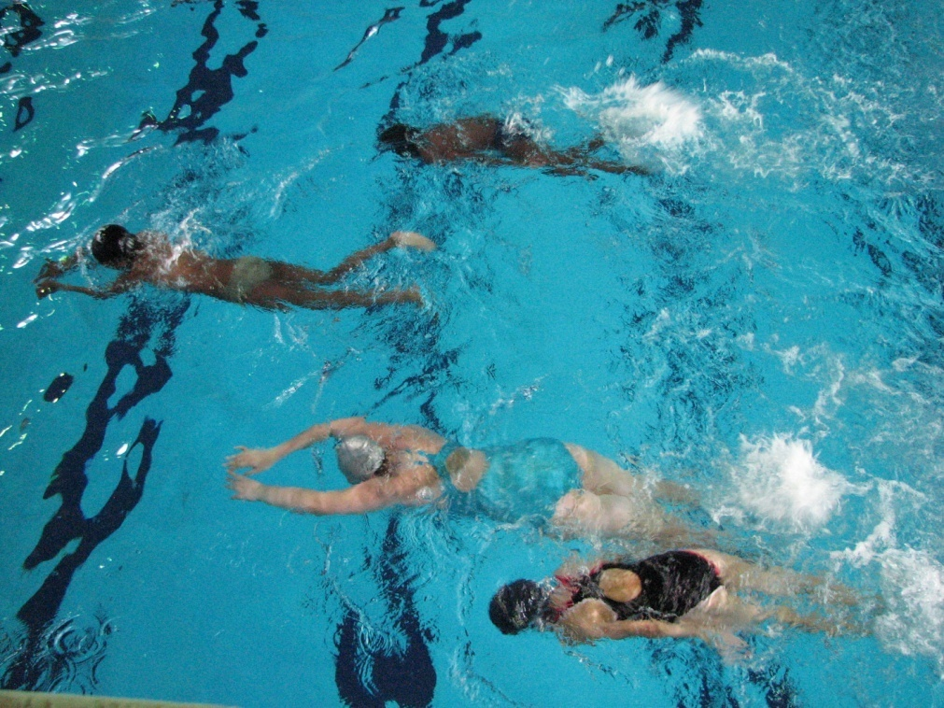
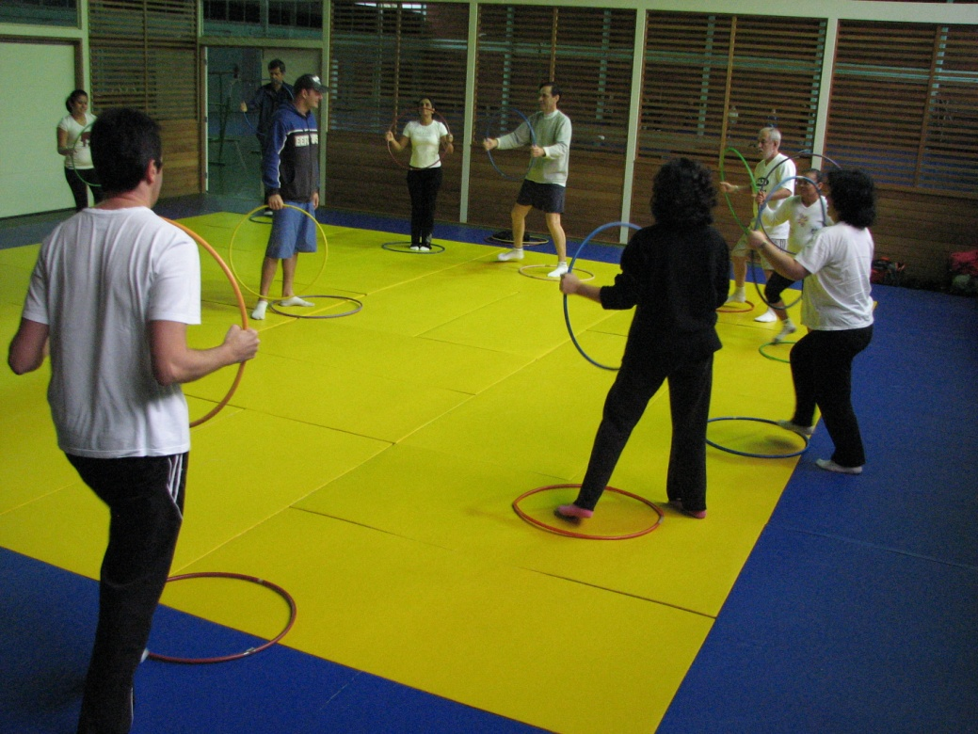
Culture and Extension
The Culture and Extension Office aims to complement the education and the research seeking interaction between the academic community and the society.
Managed by a specific Dean’s Office, extension activities are organized as following:

Slide 32
Continuing Education
The goal of these courses is to provide professional qualification and improvement for students, professionals and whoever may be interested in the field of Physical Education, Sport and similar themes. The programs are subdivided in Cultural Diffusion, Updating, Improvement and Specialization.

Slide 33
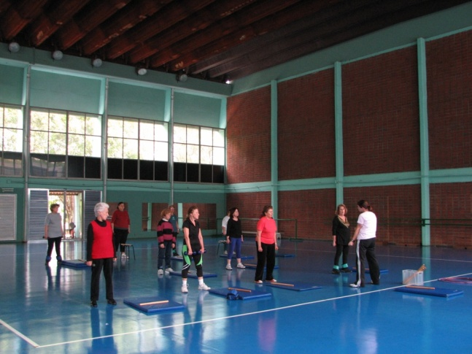
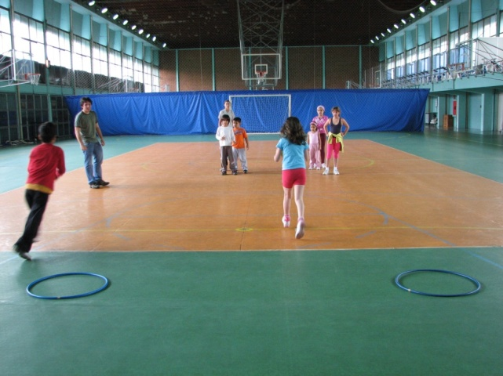
Community Courses
These programs consist on physical activities supervised by capable and experienced professionals. Besides being a service provision to the community, the classes are also a field for practical training to the students and for research in Physical Education and Sport. The programs are oriented to a diversified population with the objective to promote health and quality of life.

Slide 34
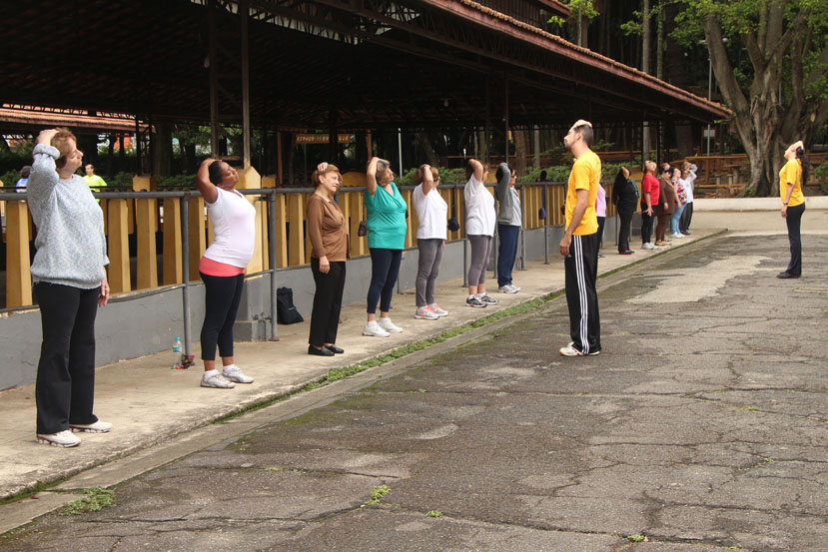
Other Actions
Exercise and Heart Project
The goal of this project is to encourage and to enable the safe practice of physical exercise, seeking to improve and to maintain the quality of life. Expert instructors offer people in public places free information on health, physical evaluation and orientation / prescription of exercises. The project is carried out by the Laboratory of Exercise Hemodynamic.
Partnership with the Heart Institute
EEFE supports the cardiovascular rehabilitation program by InCor (Heart Institute of the Clinics Hospital).

Slide 35
International

Slide 36
International Cooperation
The School seeks international insertion of the researches by means of cooperation with partner institutions:
Deutsche Sporthochschule Köln - Germany (exchange program)
Université Libre de Bruxelles - Belgium (exchange program)
Universidad Politécnica de Madrid - Spain (exchange program)
Oregon Health & Science University – USA (exchange program)
Agro Paris Tech - France (research)
Hogeschool van Amsterdam - Holland (exchange program)
Universi`tá Degli Studi Di Roma “Foro Itálico” - Italy (exchange program)
University of Tsukuba - Japan (exchange program)
Universidade do Porto - Portugal (exchange program)
Nottingham Trent University – UK (exchange program)
University of Worcester – UK (exchange program)
Loughborough University – UK (Exchange program)

Slide 37
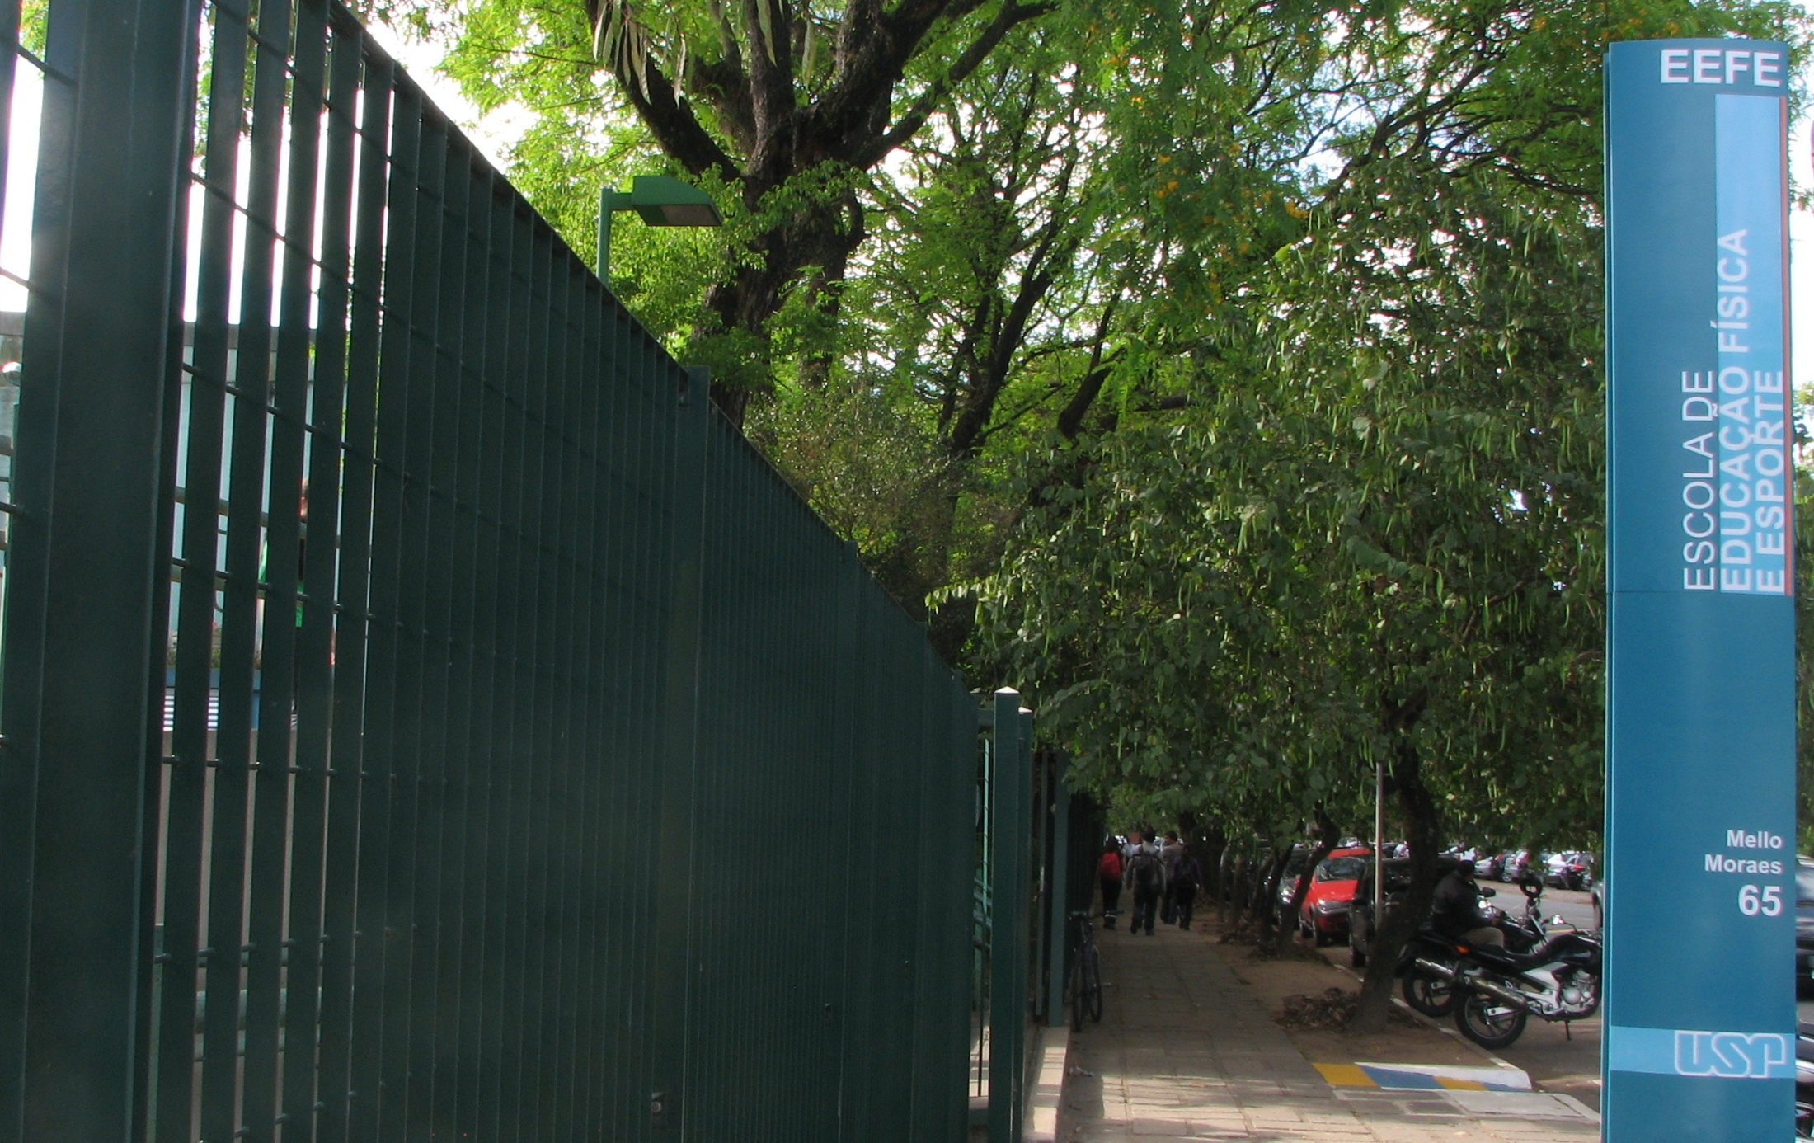
www.eefe.usp.br/en

